Slide 1
Groan
Outdated
Safe for work
Accessible / Inclusive
Hilarious
Edgy
Not safe for work
Niche
1 Cringe
5 NSFW
2 Bland
3 Chuckles
4 LOL
Read more at: memethinking.com/cringeometer

Slide 2
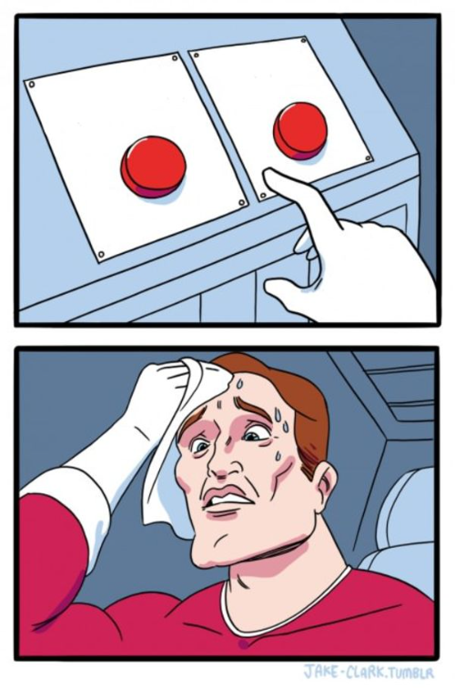
Option B
Option A
Meme Template Instructions:
Edit text
Right-click and ‘Save as Picture…’
Image is saved out and ready to go
1 Cringe
2 Bland
3 Chuckles
4 LOL
5 NSFW
WHO / REACTION
memethinking.com

Slide 3
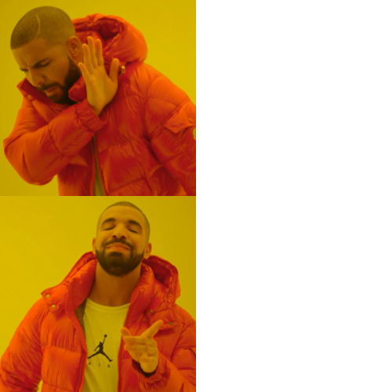
Doing something outdated / basic
Meme Template Instructions:
Edit text
Right-click and ‘Save as Picture…’
Image is saved out and ready to go
Doing something elite / extreme (can be tongue-in-cheek)
1 Cringe
2 Bland
3 Chuckles
4 LOL
5 NSFW
memethinking.com

Slide 4
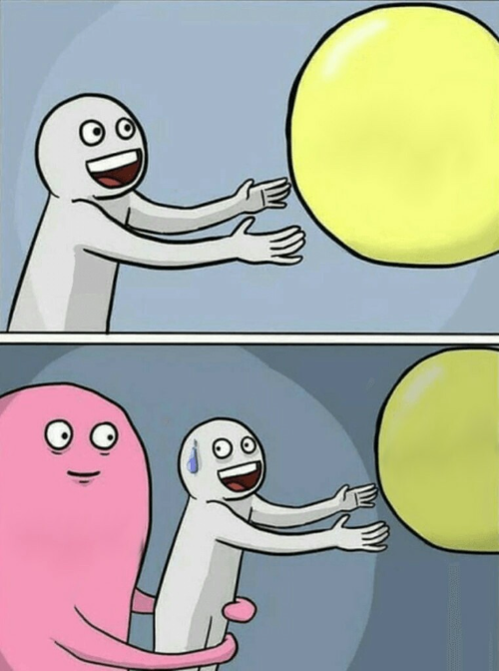
+VE CHARGE
Meme Template Instructions:
Edit text
Right-click and ‘Save as Picture…’
Image is saved out and ready to go
WHO
+VE CHARGE
-VE CHARGE
WHO
1 Cringe
2 Bland
3 Chuckles
4 LOL
5 NSFW
memethinking.com

Slide 5
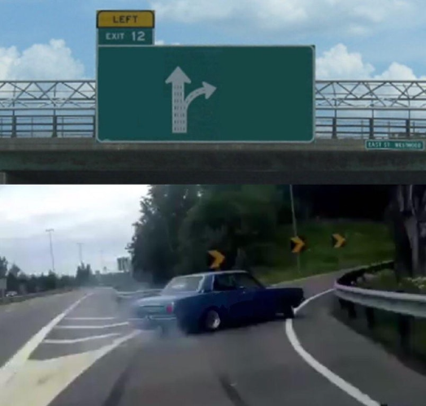
Drawn to this instead
Boring
Meme Template Instructions:
Edit text
Right-click and ‘Save as Picture…’
Image is saved out and ready to go
Who
1 Cringe
2 Bland
3 Chuckles
4 LOL
5 NSFW
memethinking.com

Slide 6
WHO (Optional)
Meme Template Instructions:
Edit text
Right-click and ‘Save as Picture…’
Image is saved out and ready to go
A bold claim worth defending (or ironically the opposite)
1 Cringe
2 Bland
3 Chuckles
4 LOL
5 NSFW
memethinking.com

Slide 7
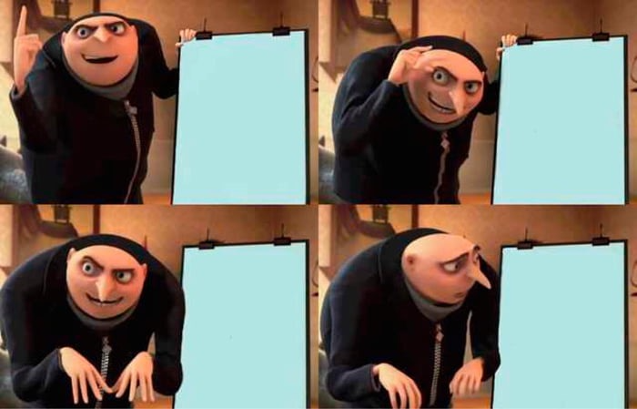
STEP 1:
A clever plan
STEP 2:
The plan gets even more clever
WHO (Optional)
Meme Template Instructions:
Edit text
Right-click and ‘Save as Picture…’
Image is saved out and ready to go
STEP 3: The inevitable way it comes unstuck
STEP 3: The inevitable way it comes unstuck
1 Cringe
2 Bland
3 Chuckles
4 LOL
5 NSFW
memethinking.com

Slide 8
Meme Template Instructions:
Edit text
Right-click and ‘Save as Picture…’
Image is saved out and ready to go
The start of something sad
The next part (optional)
The third part (optional)
1 Cringe
2 Bland
3 Chuckles
4 LOL
5 NSFW
memethinking.com

Slide 9
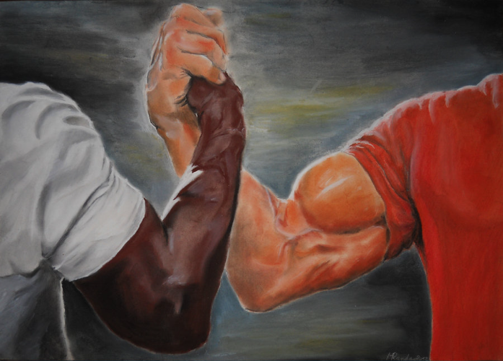
The awesome outcome (can be sarcastic)
Meme Template Instructions:
Edit text
Right-click and ‘Save as Picture…’
Image is saved out and ready to go
Team member 2
Team member 1
1 Cringe
2 Bland
3 Chuckles
4 LOL
5 NSFW
memethinking.com

Slide 10
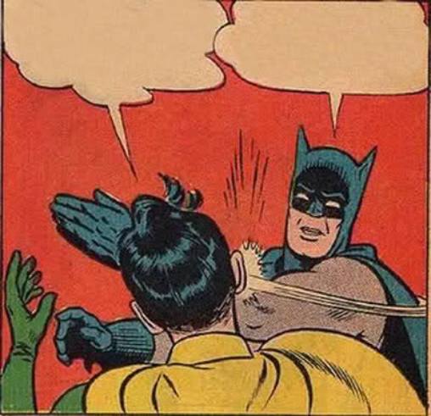
“I’m doing something annoying”
“I’m hypocritically criticising them”
Meme Template Instructions:
Edit text
Right-click and ‘Save as Picture…’
Image is saved out and ready to go
1 Cringe
2 Bland
3 Chuckles
4 LOL
5 NSFW
memethinking.com

Slide 11
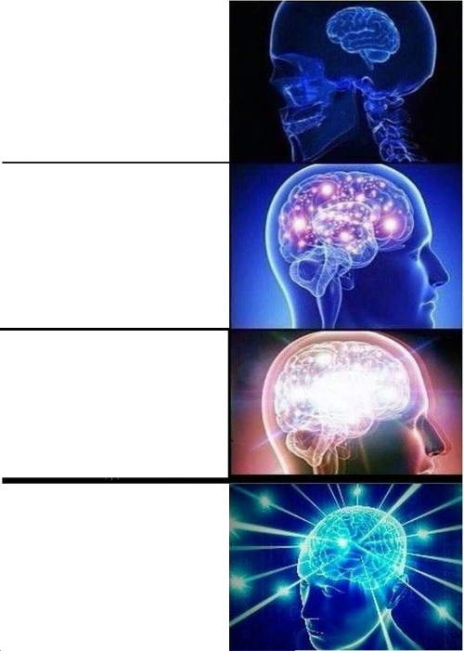
SOMETHING SMART
SOMETHING EVEN SMARTER
Meme Template Instructions:
Edit text
Right-click and ‘Save as Picture…’
Image is saved out and ready to go
SOMETHING SMARTER AGAIN
SOMETHING DUMB FOR A SMART REASON
1 Cringe
2 Bland
3 Chuckles
4 LOL
5 NSFW
memethinking.com

Slide 12
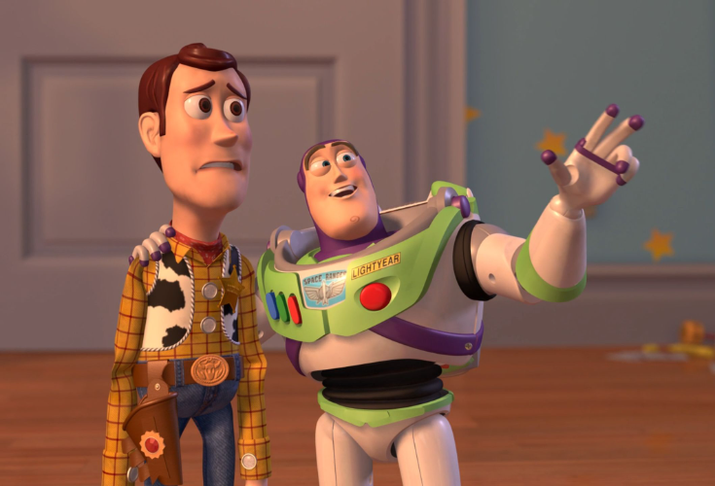
AI
Meme Template Instructions:
Edit text
Right-click and ‘Save as Picture…’
Image is saved out and ready to go
AI, EVERYWHERE
1 Cringe
2 Bland
3 Chuckles
4 LOL
5 NSFW
memethinking.com

Slide 13
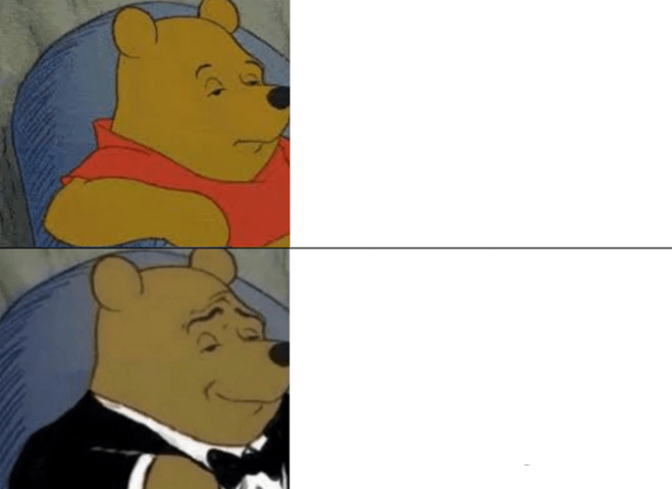
Plain Language name for something
Meme Template Instructions:
Edit text
Right-click and ‘Save as Picture…’
Image is saved out and ready to go
Fancy name / euphamism for the same thing
1 Cringe
2 Bland
3 Chuckles
4 LOL
5 NSFW
memethinking.com

Slide 14
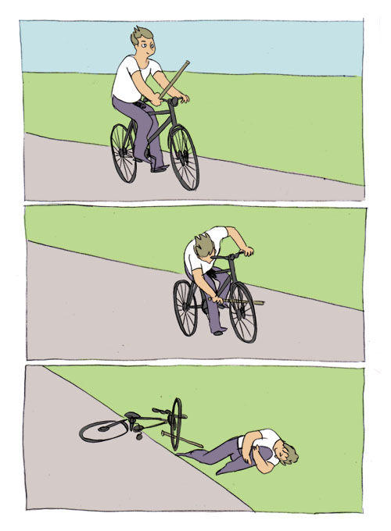
Excited to start something new
Meme Template Instructions:
Edit text
Right-click and ‘Save as Picture…’
Image is saved out and ready to go
The typical thing that gets in the way. Even better if self-inflicted
Reaction (optional)
1 Cringe
2 Bland
3 Chuckles
4 LOL
5 NSFW
memethinking.com

Slide 15
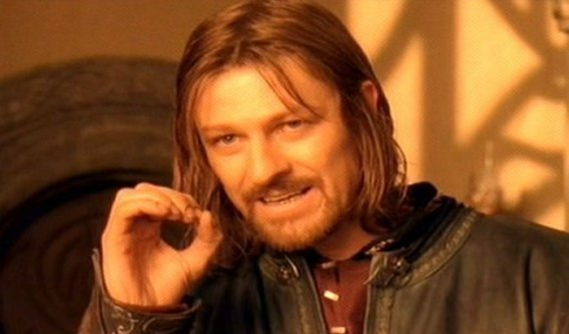
ONE DOES NOT SIMPLY
Meme Template Instructions:
Edit text
Right-click and ‘Save as Picture…’
Image is saved out and ready to go
[DO SOMETHING HARD]
1 Cringe
2 Bland
3 Chuckles
4 LOL
5 NSFW
memethinking.com

Slide 16
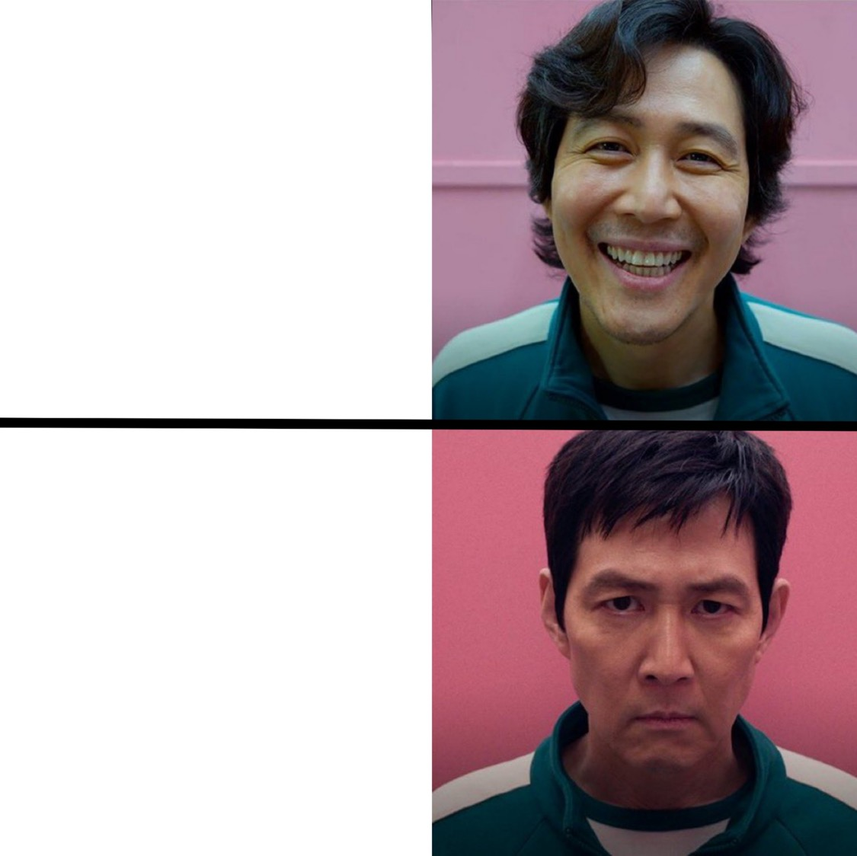
SOMETHING GREAT
Meme Template Instructions:
Edit text
Right-click and ‘Save as Picture…’
Image is saved out and ready to go
THAT INEVITABLY GOES WRONG
1 Cringe
2 Bland
3 Chuckles
4 LOL
5 NSFW
memethinking.com

Slide 17
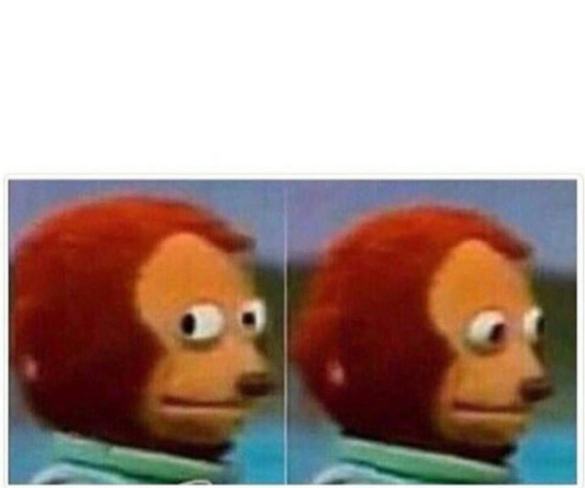
Some premise about something relatable (Optional)
An embarrassing behaviour or thought you have about the relatable thing.
Meme Template Instructions:
Edit text
Right-click and ‘Save as Picture…’
Image is saved out and ready to go
1 Cringe
2 Bland
3 Chuckles
4 LOL
5 NSFW
memethinking.com

Slide 18
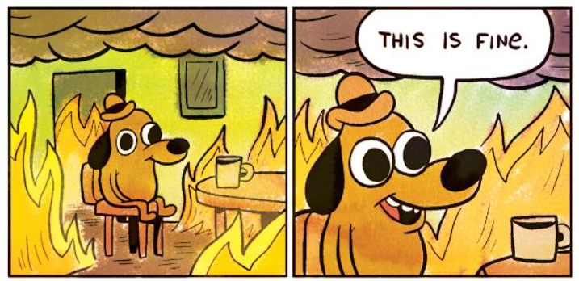
Some totally relatable situation that always goes bad
Meme Template Instructions:
Edit text
Right-click and ‘Save as Picture…’
Image is saved out and ready to go
1 Cringe
2 Bland
3 Chuckles
4 LOL
5 NSFW
memethinking.com

Slide 19
SOME INSANE THEORY
Meme Template Instructions:
Edit text
Right-click and ‘Save as Picture…’
Image is saved out and ready to go
THAT MIGHT JUST TURN OUT TO BE TRUE
1 Cringe
2 Bland
3 Chuckles
4 LOL
5 NSFW
memethinking.com

Slide 20
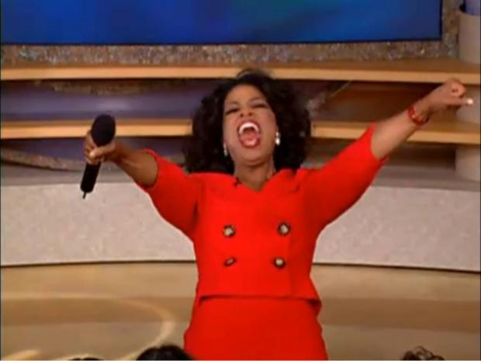
YOU GET A THING
YOU GET A THING
Meme Template Instructions:
Edit text
Right-click and ‘Save as Picture…’
Image is saved out and ready to go
EVERYBODY GETS A THING!!!
1 Cringe
5 NSFW
2 Bland
3 Chuckles
4 LOL
memethinking.com

Slide 21
Meme Template Instructions:
Edit text
Right-click and ‘Save as Picture…’
Image is saved out and ready to go
MOTIVATION If you’re tired, you just don’t want it enough
1 Cringe
2 Bland
3 Chuckles
4 LOL
5 NSFW
memethinking.com

Slide 22
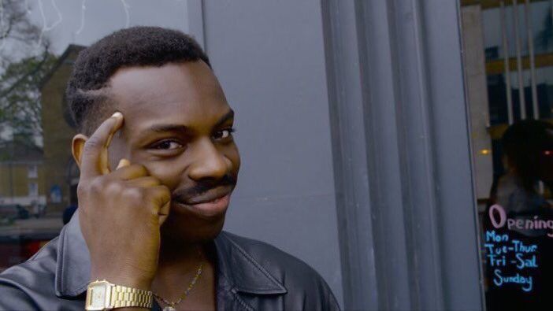
SOMETHING SMART
Meme Template Instructions:
Edit text
Right-click and ‘Save as Picture…’
Image is saved out and ready to go
THE TWIST THAT MAKES IT SEEM LESS SMART
1 Cringe
2 Bland
3 Chuckles
4 LOL
5 NSFW
memethinking.com

Slide 23
SOMETHING RELATABLE
Meme Template Instructions:
Edit text
Right-click and ‘Save as Picture…’
Image is saved out and ready to go
1 Cringe
2 Bland
3 Chuckles
4 LOL
5 NSFW
THE TWIST THAT MAKES IT SEEM SUSPICIOUS
memethinking.com

Slide 24
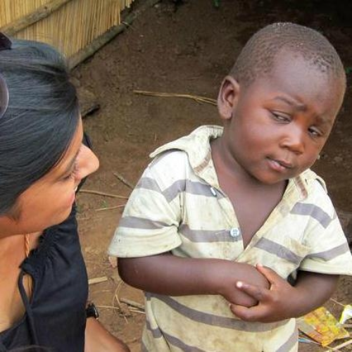
SOMETHING RELATABLE
Meme Template Instructions:
Edit text
Right-click and ‘Save as Picture…’
Image is saved out and ready to go
THE TWIST THAT MAKES IT SEEM SUSPICIOUS
1 Cringe
2 Bland
3 Chuckles
4 LOL
5 NSFW
memethinking.com

Slide 25
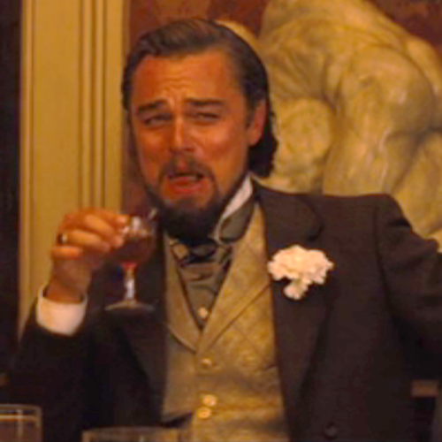
SOMETHING RELATABLE
Meme Template Instructions:
Edit text
Right-click and ‘Save as Picture…’
Image is saved out and ready to go
THE TWIST THAT MAKES IT SEEM CRUEL OR A TWIST OF FATE AT SOMEONE’S EXPENSE
1 Cringe
2 Bland
3 Chuckles
4 LOL
5 NSFW
memethinking.com

Slide 26
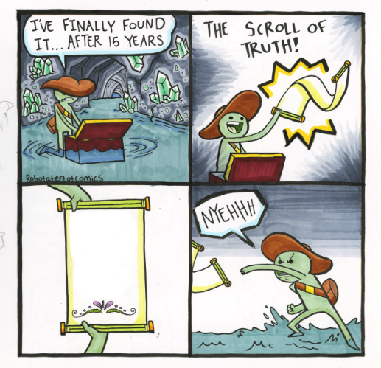
Meme Template Instructions:
Edit text
Right-click and ‘Save as Picture…’
Image is saved out and ready to go
A truth most people will ignore
1 Cringe
2 Bland
3 Chuckles
4 LOL
5 NSFW
memethinking.com

Slide 27
A truth most people will ignore
Meme Template Instructions:
Edit text
Right-click and ‘Save as Picture…’
Image is saved out and ready to go
1 Cringe
2 Bland
3 Chuckles
4 LOL
5 NSFW
memethinking.com

Slide 28
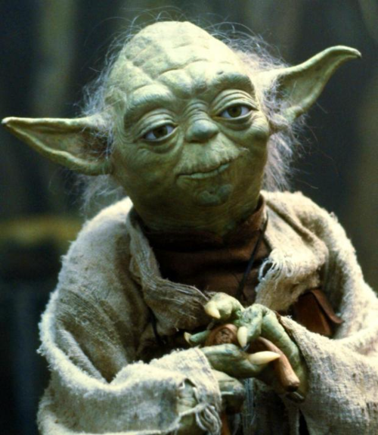
A PIECE OF WISDOM THIS IS
Meme Template Instructions:
Edit text
Right-click and ‘Save as Picture…’
Image is saved out and ready to go
1 Cringe
2 Bland
3 Chuckles
4 LOL
5 NSFW
SARCASTIC TONE IT HAS
memethinking.com

Slide 29
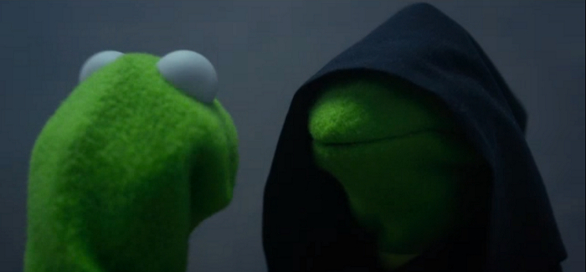
THE RIGHT THING TO DO
Meme Template Instructions:
Edit text
Right-click and ‘Save as Picture…’
Image is saved out and ready to go
THE TEMPTING THING TO DO
1 Cringe
2 Bland
3 Chuckles
4 LOL
5 NSFW
memethinking.com

Slide 30
Something awkward but relatable happens
Meme Template Instructions:
Edit text
Right-click and ‘Save as Picture…’
Image is saved out and ready to go
1 Cringe
2 Bland
3 Chuckles
4 LOL
5 NSFW
memethinking.com

Slide 31
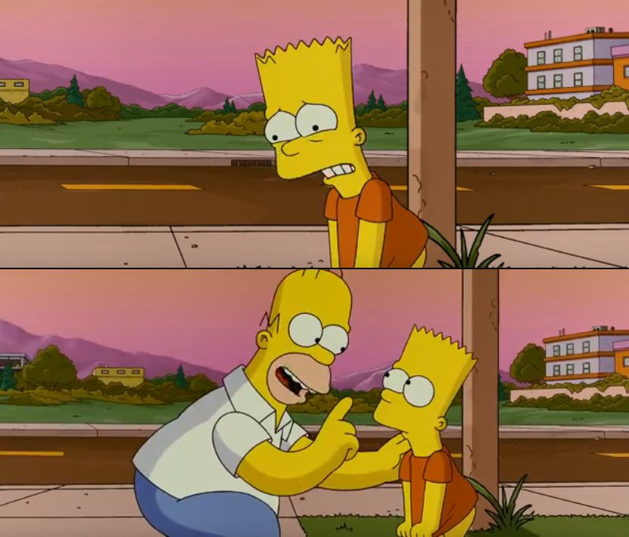
THAT WAS THE HARDEST CHANGE WE’VE EVER SEEN
Meme Template Instructions:
Edit text
Right-click and ‘Save as Picture…’
Image is saved out and ready to go
THAT WAS THE HARDEST CHANGE WE’VE EVER SEEN, SO FAR
1 Cringe
2 Bland
3 Chuckles
4 LOL
5 NSFW
memethinking.com

Slide 32
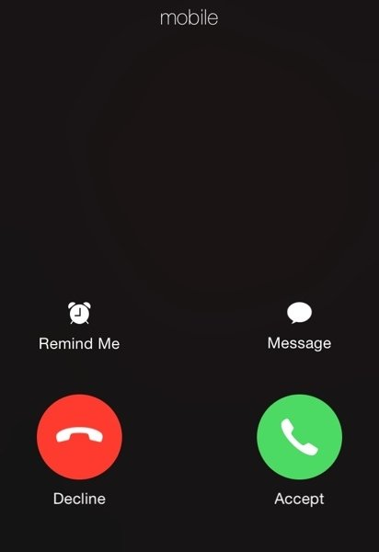
SOMEONE / THING YOU SHOULD REALLY ENGAGE WITH
Meme Template Instructions:
Edit text
Right-click and ‘Save as Picture…’
Image is saved out and ready to go
1 Cringe
2 Bland
3 Chuckles
4 LOL
5 NSFW
memethinking.com

Slide 33
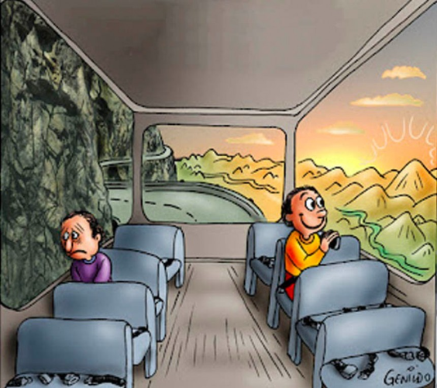
THE POSITIVE PERSPECTIVE ON THAT SAME THING
THE NEGATIVE PERSPECTIVE ON A THING
Meme Template Instructions:
Edit text
Right-click and ‘Save as Picture…’
Image is saved out and ready to go
1 Cringe
2 Bland
3 Chuckles
4 LOL
5 NSFW
memethinking.com

Slide 34
SOMETHING EXCITING (OR NOT EXCITING)
Meme Template Instructions:
Edit text
Right-click and ‘Save as Picture…’
Image is saved out and ready to go
TAKE MY MONEY!
1 Cringe
2 Bland
3 Chuckles
4 LOL
5 NSFW
memethinking.com

Slide 35
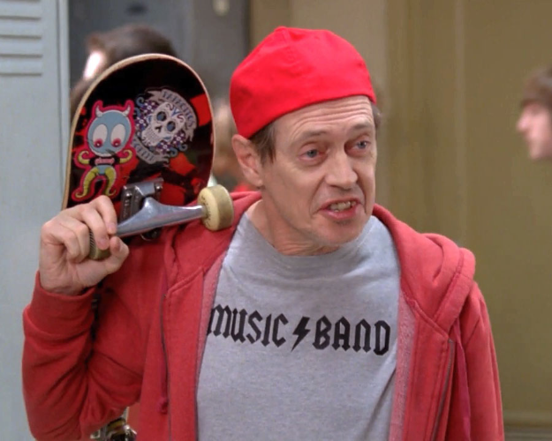
Meme Template Instructions:
Edit text
Right-click and ‘Save as Picture…’
Image is saved out and ready to go
1 Cringe
2 Bland
3 Chuckles
4 LOL
5 NSFW
THE TRENDY “LINGO” USED AWKWARDLY
memethinking.com

Slide 36
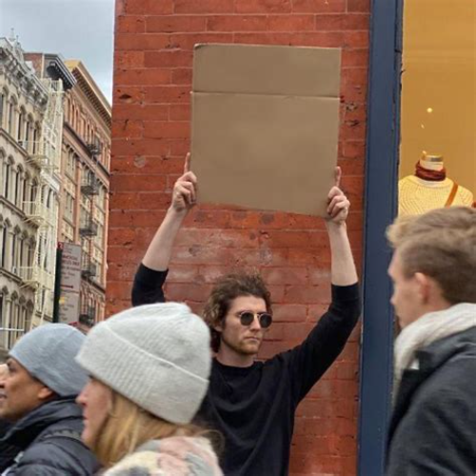
Something you’re passionate about
Meme Template Instructions:
Edit text
Right-click and ‘Save as Picture…’
Image is saved out and ready to go
1 Cringe
2 Bland
3 Chuckles
4 LOL
5 NSFW
memethinking.com

Slide 37
YO DAWG, I HEARD YOU LIKE RETROS
Meme Template Instructions:
Edit text
Right-click and ‘Save as Picture…’
Image is saved out and ready to go
SO I PUT A RETRO IN YOUR RETRO SO YOU CAN REFLECT WHILE YOU REFLECT
1 Cringe
2 Bland
3 Chuckles
4 LOL
5 NSFW
memethinking.com

Slide 38
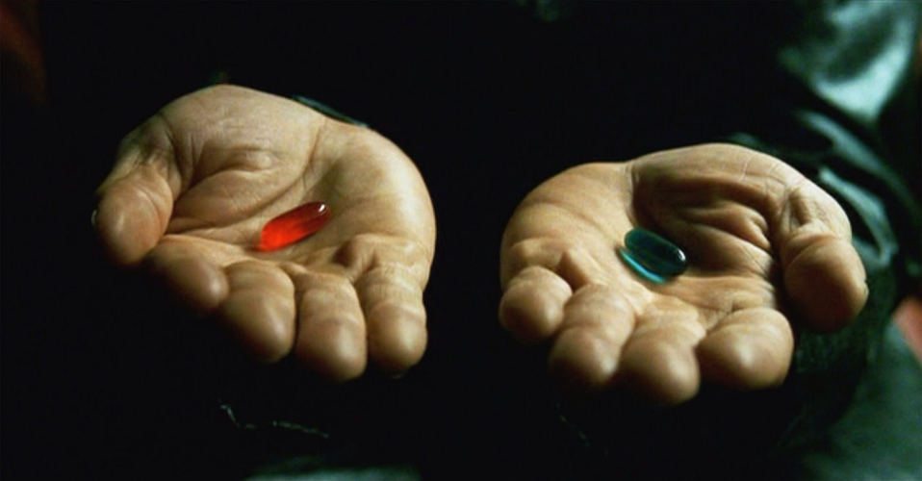
Meme Template Instructions:
Edit text
Right-click and ‘Save as Picture…’
Image is saved out and ready to go
A DIFFICULT CHOICE, OPTION A
A DIFFICULT CHOICE, OPTION B
1 Cringe
2 Bland
3 Chuckles
4 LOL
5 NSFW
memethinking.com

Slide 39
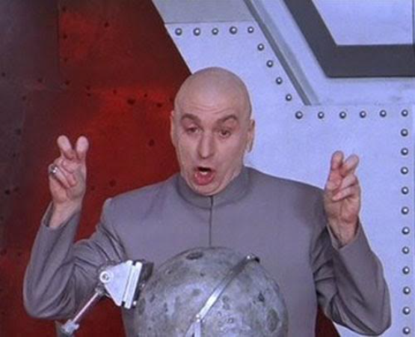
Meme Template Instructions:
Edit text
Right-click and ‘Save as Picture…’
Image is saved out and ready to go
“BUZZWORD”
1 Cringe
5 NSFW
2 Bland
3 Chuckles
4 LOL
memethinking.com

Slide 40
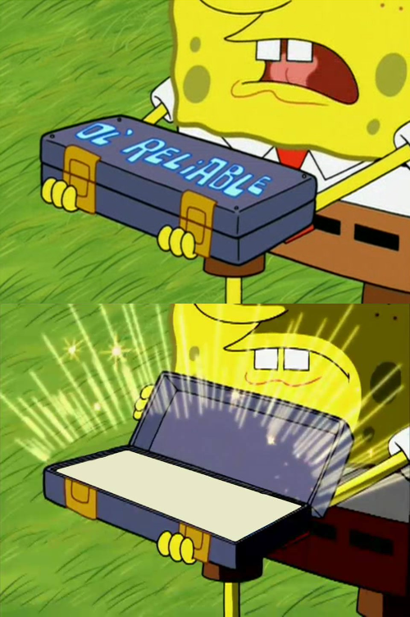
AGILE COACH
Meme Template Instructions:
Edit text
Right-click and ‘Save as Picture…’
Image is saved out and ready to go
RETROS
1 Cringe
2 Bland
3 Chuckles
4 LOL
5 NSFW
memethinking.com

Slide 41
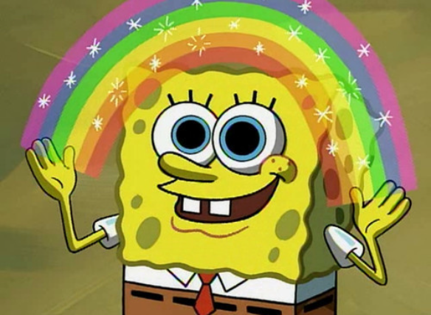
Meme Template Instructions:
Edit text
Right-click and ‘Save as Picture…’
Image is saved out and ready to go
TEXT
1 Cringe
2 Bland
3 Chuckles
4 LOL
5 NSFW
memethinking.com

Slide 42
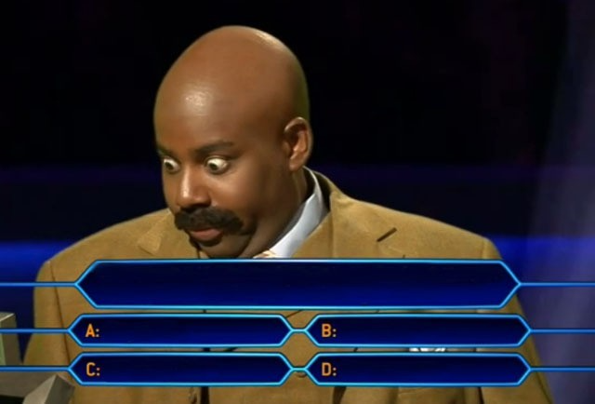
Meme Template Instructions:
Edit text
Right-click and ‘Save as Picture…’
Image is saved out and ready to go
A really tough question
With 4
Really
Tough
Answers
1 Cringe
2 Bland
3 Chuckles
4 LOL
5 NSFW
memethinking.com

Slide 43
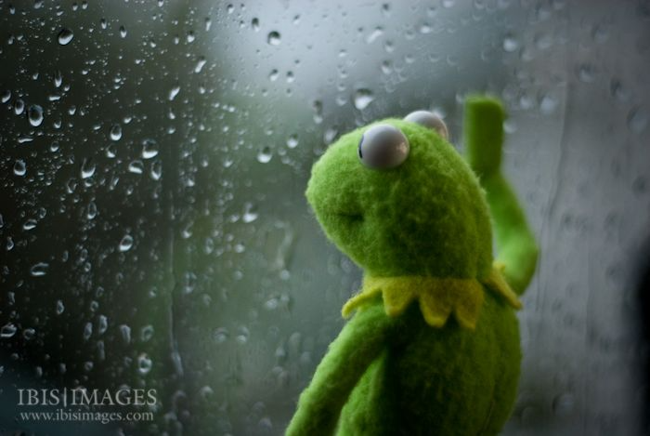
TELLING A JOKE ABOUT SOMETHING SAD
Meme Template Instructions:
Edit text
Right-click and ‘Save as Picture…’
Image is saved out and ready to go
OR STATING SOMETHING THAT SHOULDN’T BE SAD (ie KERMIT IS BEING OVER-DRAMATIC)
1 Cringe
2 Bland
3 Chuckles
4 LOL
5 NSFW
memethinking.com

Slide 44
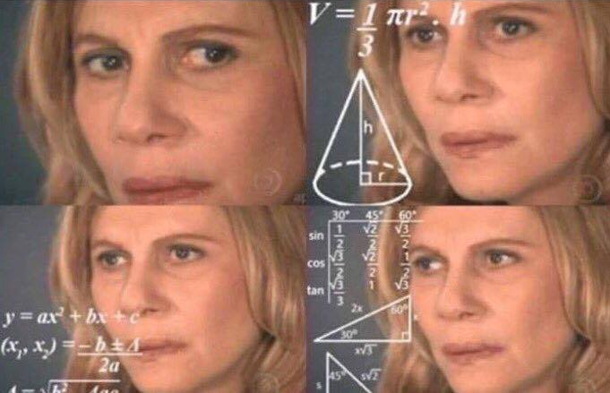
Something that should be simple, but is in fact quite confusing
Meme Template Instructions:
Edit text
Right-click and ‘Save as Picture…’
Image is saved out and ready to go
1 Cringe
2 Bland
3 Chuckles
4 LOL
5 NSFW
memethinking.com

Slide 45
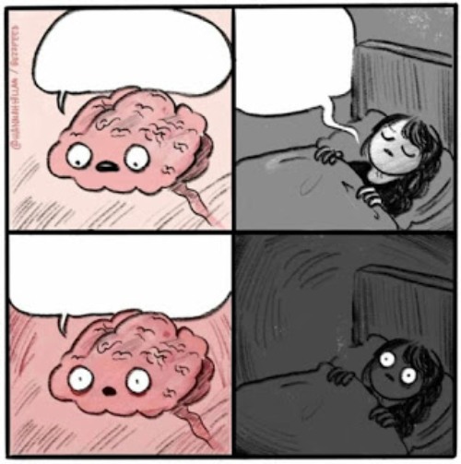
REMEMBERED SOMETHING IMPORTANT
GO TO SLEEP
Meme Template Instructions:
Edit text
Right-click and ‘Save as Picture…’
Image is saved out and ready to go
REMEBERED SOMETHING SUPER IMPORTANT
1 Cringe
2 Bland
3 Chuckles
4 LOL
5 NSFW
memethinking.com

Slide 46
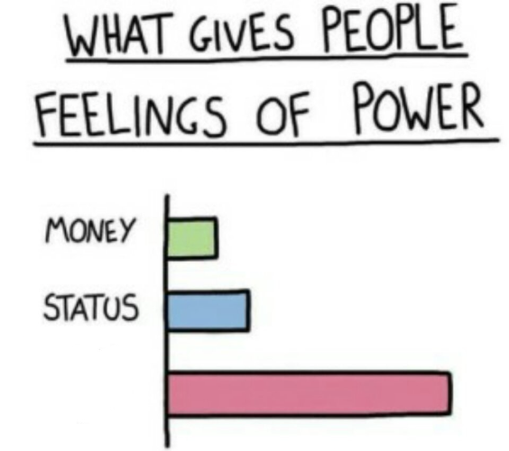
Meme Template Instructions:
Edit text
Right-click and ‘Save as Picture…’
Image is saved out and ready to go
Jira Admin Privileges
1 Cringe
2 Bland
3 Chuckles
4 LOL
5 NSFW
memethinking.com

Slide 47
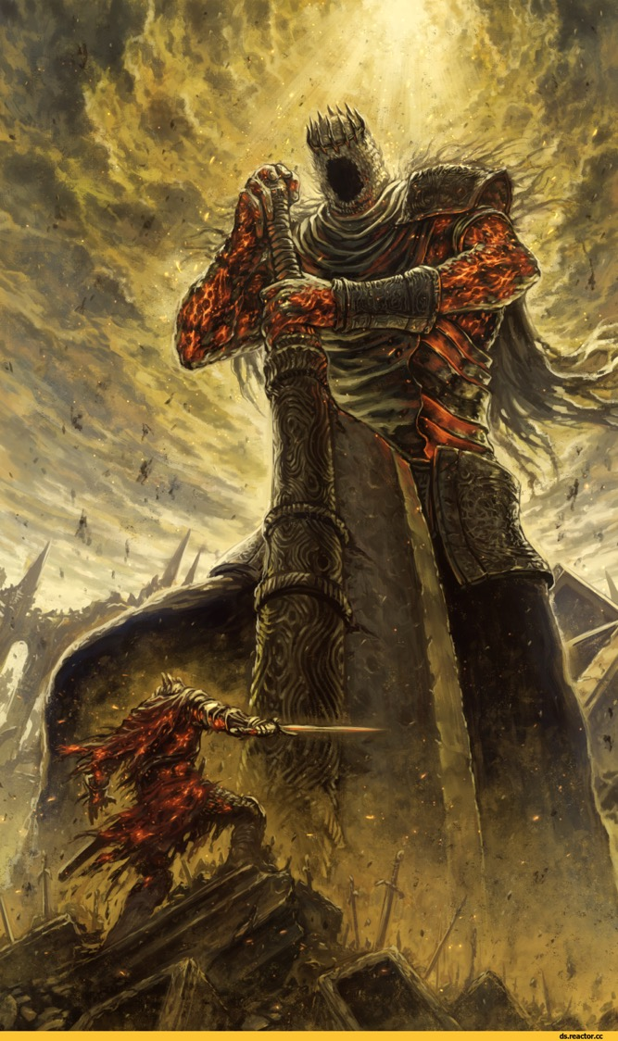
A POWERFUL AND NOBLE CHALLENGE
Meme Template Instructions:
Edit text
Right-click and ‘Save as Picture…’
Image is saved out and ready to go
WHO
1 Cringe
2 Bland
3 Chuckles
4 LOL
5 NSFW
memethinking.com

Slide 48
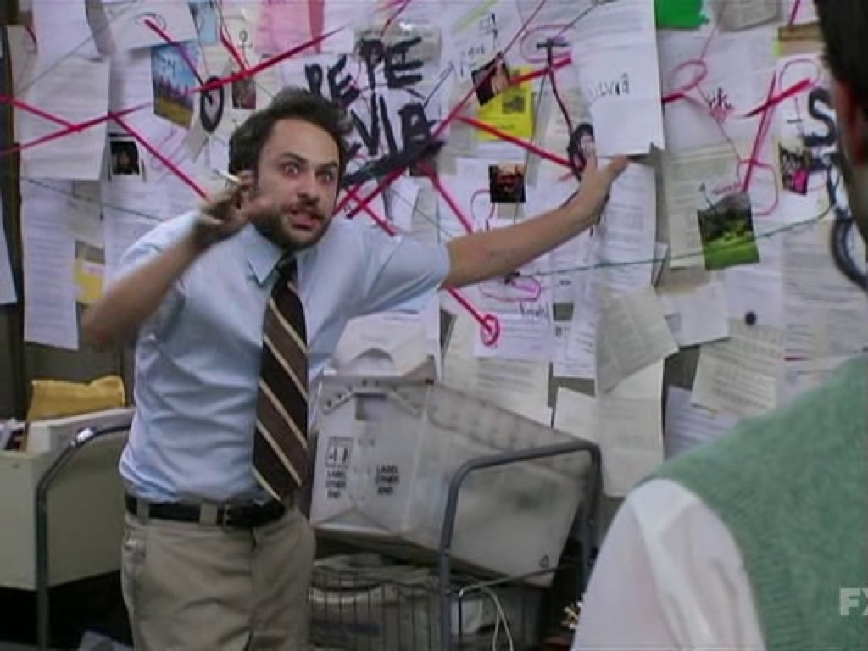
Meme Template Instructions:
Edit text
Right-click and ‘Save as Picture…’
Image is saved out and ready to go
ME TRYING TO EXPLAIN MY OVERLY COMPLEX PLAN OR CONSPIRACY THEORY
1 Cringe
2 Bland
3 Chuckles
4 LOL
5 NSFW
memethinking.com

Slide 49
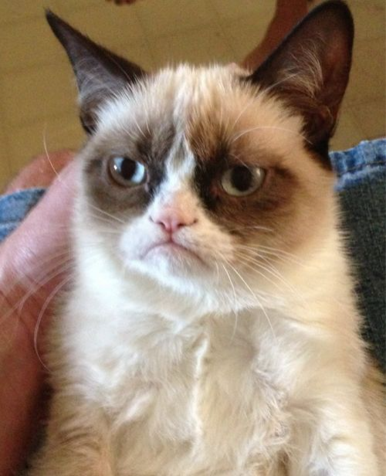
Meme Template Instructions:
Edit text
Right-click and ‘Save as Picture…’
Image is saved out and ready to go
SOMETHING I’M REALLY NOT HAPPY ABOUT
1 Cringe
2 Bland
3 Chuckles
4 LOL
5 NSFW
memethinking.com

Slide 50
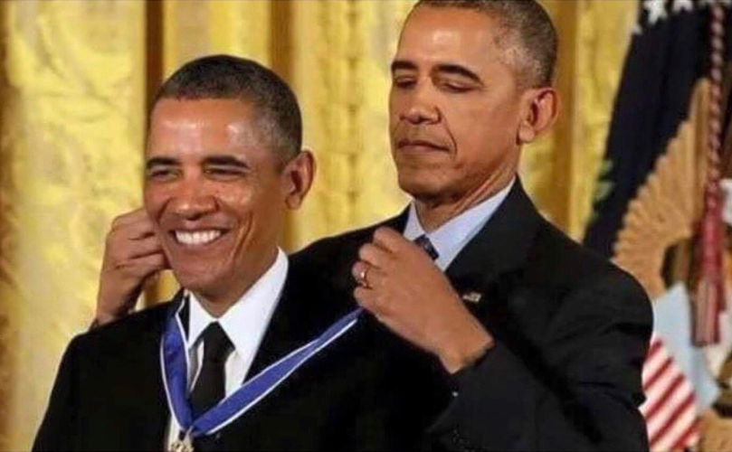
Meme Template Instructions:
Edit text
Right-click and ‘Save as Picture…’
Image is saved out and ready to go
WHO
BEHAVIOUR THAT SEEMS SELF-CONGRATULATORY
1 Cringe
2 Bland
3 Chuckles
4 LOL
5 NSFW
memethinking.com

Slide 51
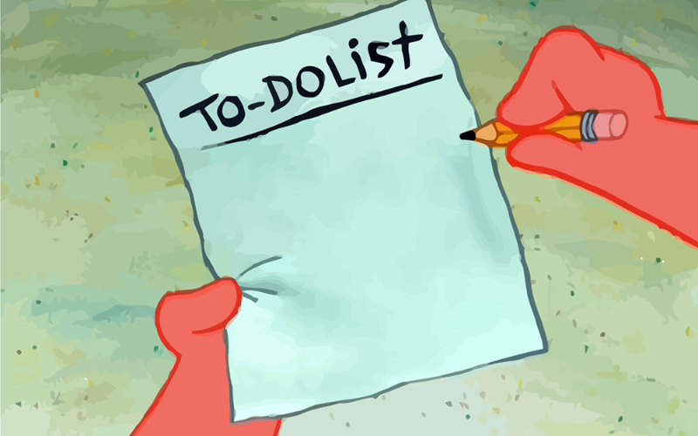
Meme Template Instructions:
Edit text
Right-click and ‘Save as Picture…’
Image is saved out and ready to go
Do the thing
Do the other thing
Also, bananas
1 Cringe
2 Bland
3 Chuckles
4 LOL
5 NSFW
memethinking.com

Slide 52
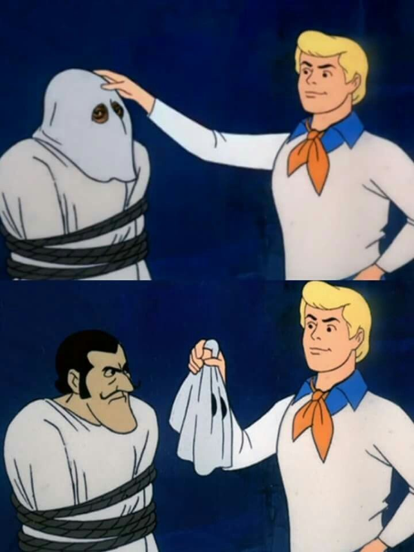
A RELATABLE PROBLEM
Meme Template Instructions:
Edit text
Right-click and ‘Save as Picture…’
Image is saved out and ready to go
THE TRUE ROOT CAUSE
1 Cringe
5 NSFW
2 Bland
3 Chuckles
4 LOL
memethinking.com

Slide 53
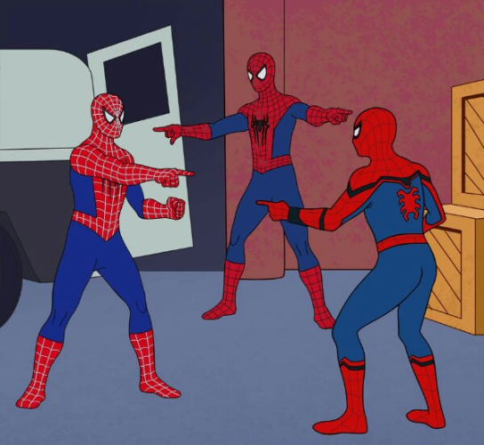
THAT ARE
Meme Template Instructions:
Edit text
Right-click and ‘Save as Picture…’
Image is saved out and ready to go
THREE THINGS
VERY SIMILAR
1 Cringe
2 Bland
3 Chuckles
4 LOL
5 NSFW
memethinking.com

Slide 54
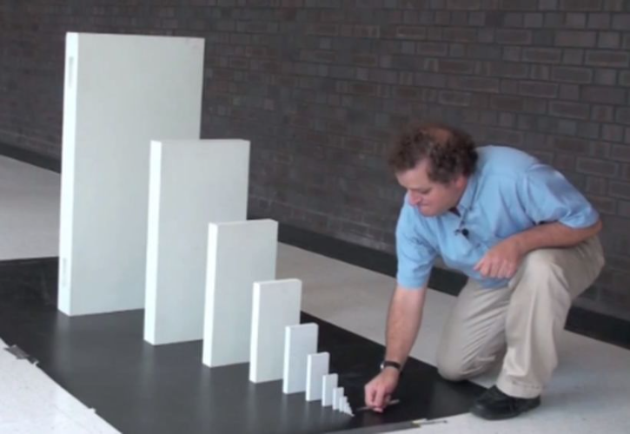
THE UNEXPECTED SNOWBALL RESULT
Meme Template Instructions:
Edit text
Right-click and ‘Save as Picture…’
Image is saved out and ready to go
A SMALL INOCUOUS ACTION
1 Cringe
2 Bland
3 Chuckles
4 LOL
5 NSFW
memethinking.com

Slide 55
Meme Template Instructions:
Edit text
Right-click and ‘Save as Picture…’
Image is saved out and ready to go
CONGRATULATIONS ON THAT THING YOU DID
1 Cringe
5 NSFW
2 Bland
3 Chuckles
4 LOL
memethinking.com

Slide 56
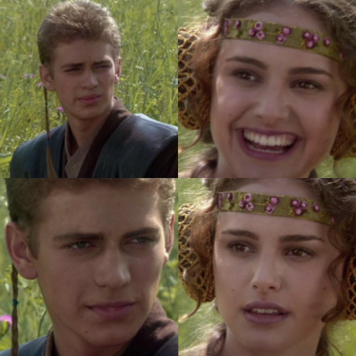
Meme Template Instructions:
Edit text
Right-click and ‘Save as Picture…’
Image is saved out and ready to go
A STATEMENT THAT COULD BE INTERPRETTED TWO WAYS
THE GENEROUS INTERPRETATION, RIGHT?
1 Cringe
2 Bland
3 Chuckles
4 LOL
5 NSFW
THE GENEROUS INTERPRETATION, RIGHT?
memethinking.com

Slide 57
I’M GONNA NEED YOU TO GO AHEAD AND DO A THING THAT’S SUPER ANNOYING
Meme Template Instructions:
Edit text
Right-click and ‘Save as Picture…’
Image is saved out and ready to go
THAT WOULD BE GREEEAT
1 Cringe
2 Bland
3 Chuckles
4 LOL
5 NSFW
memethinking.com

Slide 58
Meme Template Instructions:
Edit text
Right-click and ‘Save as Picture…’
Image is saved out and ready to go
SOMETHING RISKY THAT HAPPENED
1 Cringe
2 Bland
3 Chuckles
4 LOL
5 NSFW
memethinking.com

Slide 59
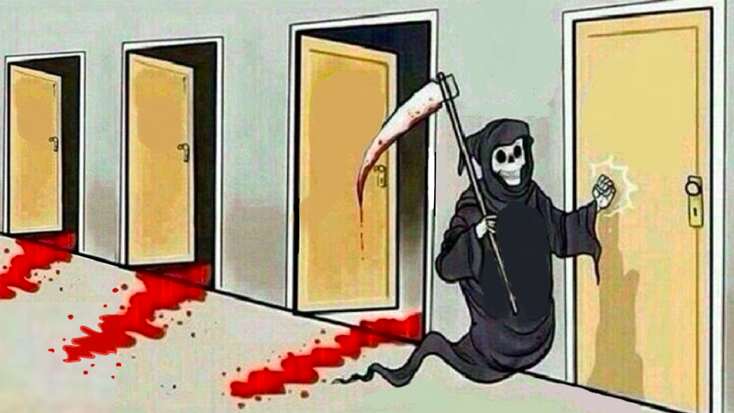
TEXT
TEXT
TEXT
TEXT
Meme Template Instructions:
Edit text
Right-click and ‘Save as Picture…’
Image is saved out and ready to go
TEXT
1 Cringe
2 Bland
3 Chuckles
4 LOL
5 NSFW
memethinking.com

Slide 60
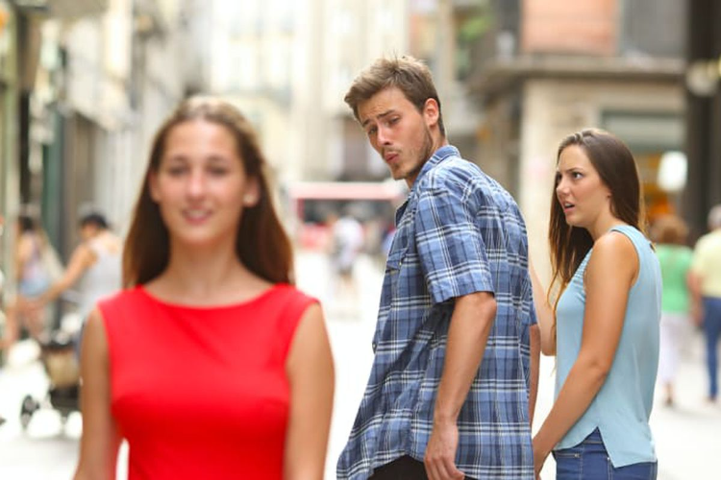
Meme Template Instructions:
Edit text
Right-click and ‘Save as Picture…’
Image is saved out and ready to go
TEXT
NSFW
TEXT
1 Cringe
2 Bland
3 Chuckles
4 LOL
5 NSFW
memethinking.com

Slide 61
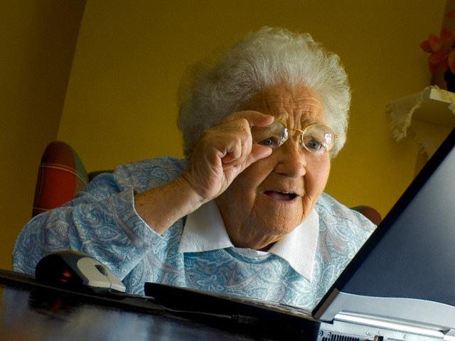
TEXT
Meme Template Instructions:
Edit text
Right-click and ‘Save as Picture…’
Image is saved out and ready to go
NSFW
1 Cringe
2 Bland
3 Chuckles
4 LOL
5 NSFW
memethinking.com

Slide 62
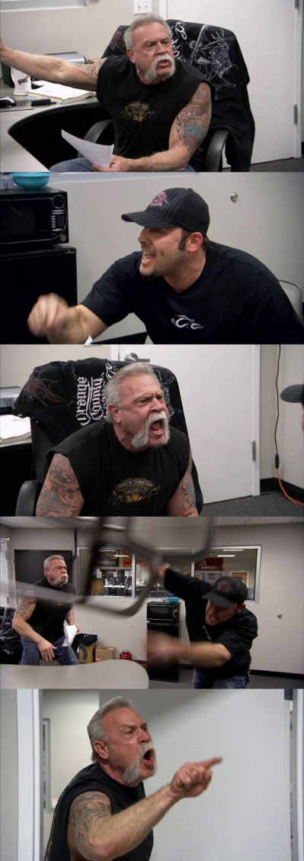
TEXT
TEXT
Meme Template Instructions:
Edit text
Right-click and ‘Save as Picture…’
Image is saved out and ready to go
TEXT
1 Cringe
2 Bland
3 Chuckles
4 LOL
5 NSFW
memethinking.com
TEXT

Slide 63
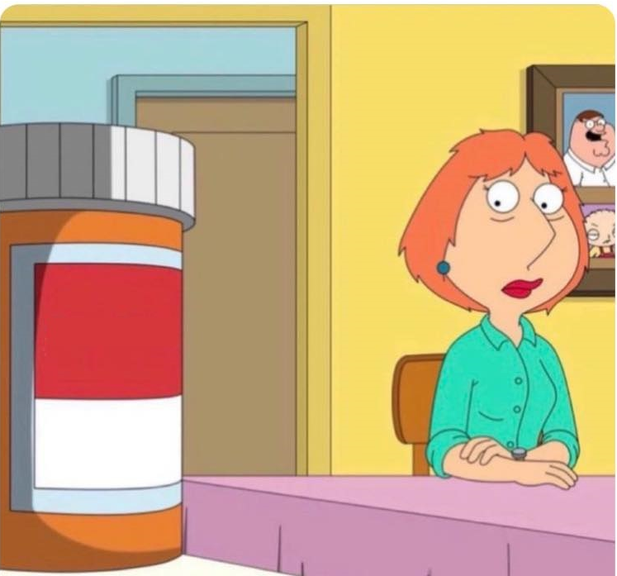
Meme Template Instructions:
Edit text
Right-click and ‘Save as Picture…’
Image is saved out and ready to go
THE ADDICTION
WHO
1 Cringe
2 Bland
3 Chuckles
4 LOL
5 NSFW
memethinking.com

Slide 64
I DON’T OFTEN X
Meme Template Instructions:
Edit text
Right-click and ‘Save as Picture…’
Image is saved out and ready to go
NSFW
1 Cringe
2 Bland
3 Chuckles
4 LOL
5 NSFW
BUT WHEN I DO, I Y
memethinking.com

Slide 65
Meme Template Instructions:
Edit text
Right-click and ‘Save as Picture…’
Image is saved out and ready to go
CREEPY GENE SAYS CREEPY THINGS
1 Cringe
5 NSFW
2 Bland
3 Chuckles
4 LOL
memethinking.com

